Slide 1
San Francisco Crime Analysis and Classification
Dylan Karman
Flatiron School Data Science, Capstone Project
10/19/2020

Slide 2
Problem Statement
How can the San Francisco Police Department better allocate their time and resources?
How can they become more proactive instead of reactive?
Notes:
San Francisco is a large city with a very dense population. With more people comes more problems, and more specifically, more crime. San Francisco sees approximately 150,000 crimes a year, which is a little over 400 everyday! It begs the question, how can the SF police department better allocate their time and resources based on the data? And more importantly, how can they be more proactive in stopping crimes, than reactive?

Slide 3
Business Value
Better allocation of resources
Save time and money
Prevent Crime
Make the community safer
Notes:
Being able to use past years data is crucial in the fight against crime. Studying the trends that emerge through a data analysis can be beneficial when trying to decide where to allocate personnel and resources, saving the county time and money, by having units in position at the right place at the right time. Higher presence of police will have a deterrent effect and prevent some crimes from happening, which in turn, makes the community safer.

Slide 4
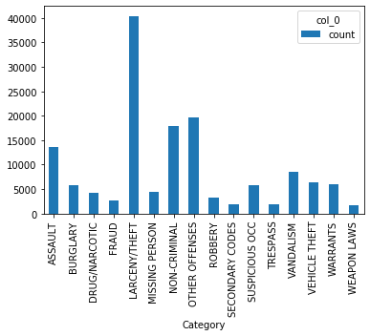
Methodology
Data Analysis
  Group and count
  the different variables
  Graph results
Notes:
A data analysis of the crime data from the past is essential for understanding how to fight crime in the future. In order to do so we must analyze the data that we have and make some basic assumptions about it. first, the data is grouped together by the variable. For the graph shown here, the category variable was grouped together by which crime type it was, and then each one was counted. As you can see here, if you were a victim of a crime in san Francisco in 2016, you were most likely a victim of larceny/theft. Knowing things like what type of crime is most likely to occur, and where it is most likely to occur, are crucial in understanding how to proactively prevent crimes instead of reacting to it.

Slide 5
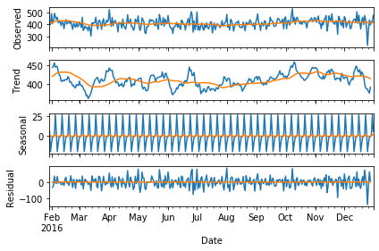
Methodology
Seasonal Decomposition
  Are there any trends in the data?
Notes:
Noticing trends in the data is important in understanding how to prevent crime. This graph shows many interesting things about the crime in SF. The observed data in the first plot graphs the data untouched. The blue line is the data, and the orange line is the mean of the data. The trend plot shows whether crime throughout the year is gaining, declining, or remaining neutral. In this case, the crime rate is very steady over the course of the year. The seasonal plot graphs whether or not the data shows a seasonal trend. In this case, the seasonality is very high visually represented by the constant spikes all year long. The residual plot filters out the noise from the data, or simply put, it filters out what the seasonal decomposition cannot interpret. If there was no noise, there would be a flat horizontal line.

Slide 6
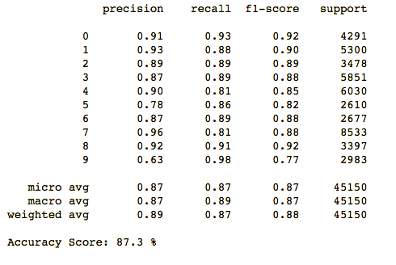
Methodology
Classification of Pd District
  Predicting which district the next crime is going to happen
Notes:
Obviously, crimes are random, but by using past data and running a classification on a certain variable, such as Pd District, it can help predict where the next crimes might happen. A logistic regression was used as the predicting model because logistic regression is good for yes/no questions such as will a crime occur here or not. With the Pd District as the target variable the model was able to predict with 87.3% certainty which district a crime will occur next.

Slide 7
Findings
Category: Larceny/theft
Day of Week: Friday
Date: January 1
Time: 12:00 noon
Pd District: Southern
Resolution: None
High Seasonality
Notes:
Through the analysis some basic assumptions can be made that can help prevent crime in SF. These are: if you are a victim of a crime in San Francisco, you are most likely to be a victim of larceny/theft. Friday is the day of the week with the most crimes. January first is the day that sees the most amount of crimes. Noon is the time at which you are most likely to become a victim of a crime. The southern district is the most crime ridden district, and when the police show up to the scene, more than likely nothing will be done legally. The crime data from 2016 shows a high seasonal trend. "Most crimes commited in big cities occur during the day, while more violent offenses happen more frequently at night, according to a new study." the SF crime data fits this study very well and would explain why most of the crimes, most notably larceny/theft, happen during the day.
https://www.usnews.com/news/cities/articles/2019-06-12/study-finds-crime-in-big-cities-is-more-likely-during-the-day

Slide 8
Findings
Classification
  87% accurate in predicting the Pd District
Notes:
By running a classification on the target variable, Pd District, the model was able to predict with an 87% certainty which district will be affected next.

Slide 9
Future Work
More data from past years
  More data = more accurate predictions
Time series analysis
Notes:
When trying to predict where crimes might happen, the more data that you have, the better. That is why, in the future, I would like to use more data, possibly from the past ten years, to analyze and see trends. Then, having used more data, I can run a time series analysis to try and predict various things based on trends that present themselves in the data.

Slide 10
Thank You
Dylan Karman
Flatiron School Data Science, Capstone Project
10/19/2020

